Slide 1
Chongqing University of Technology
ATAI
Advanced Technique of Artificial Intelligence
Chongqing University of Technology
Mining Dual Emotion for Fake News Detection
(WWW-2021)
Code：https://github.com/RMSnow/WWW2021
Reported by Ling Zhu

Slide 2
Chongqing University of Technology
ATAI
Advanced Technique of Artificial Intelligence
Chongqing University of Technology
1. Introduction
2. Motivation
3. Approach
4. Experiments
5. Conclusion
Notes:
https://www.bilibili.com/video/BV13o4y1m7c3

Slide 3
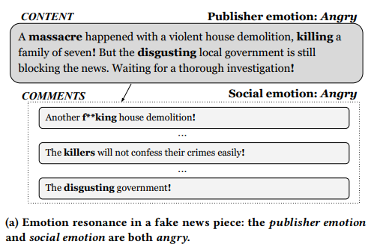
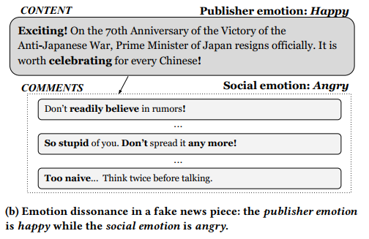
Introduction
Notes:
Chinese DataSet field:content, comments,label, content_emotions, comments100_emotions_mean_pooling, comments100_emotions_max_pooling

Slide 4
Motivation
Most existing works leverage the emotional signals of fake news content conveyed by the publishers but rarely focus on the emotions of fake news comments aroused in the crowd. However, for spreading in the crowd virally, fake news often evokes high-arousal or activating emotions of the crowd.

Slide 5
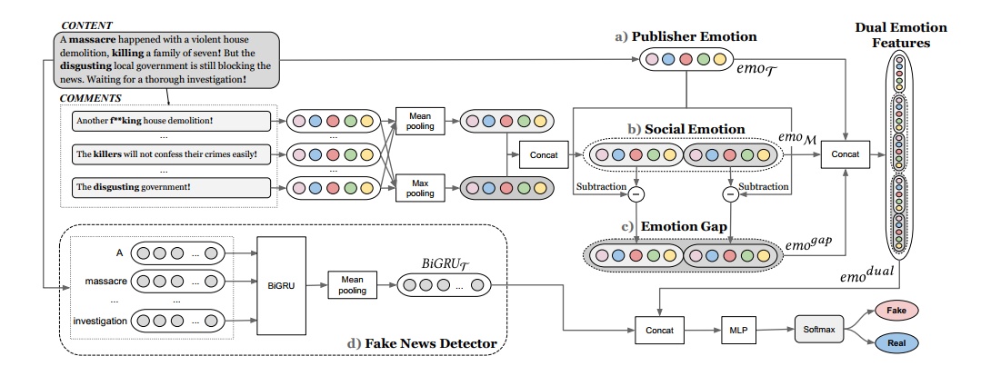
Approach

Slide 6
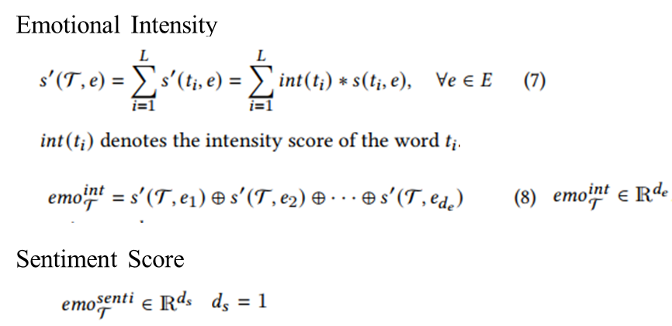
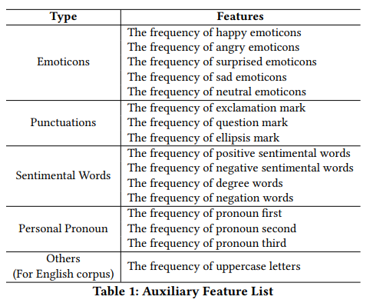
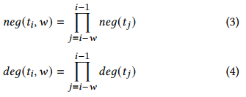
Approach
Publisher Emotion
Emotion Category
$$t_{i} in the dictionary,int\left(t_{i}\right)=1,otherwise equals 0$$
Emotional Lexicon
NRC,HowNet
for the whole text
Other Auxiliary Features
where w is the window size of the left context
For example:I am not very joyful today
Notes:
https://github.com/NVIDIA/sentiment-discovery
https://ai.baidu.com/tech/nlp/emotion_detection
Emotion Category----工具NVIDIA,Baidu AI
Emotion Lexicon,Emotional Intensity----NRC Emotion lexicon,Affective Lexicon Ontology
Sentiment Score—Vader,HowNet
Other Auxiliary Features---Wikipedia,HowNet,and others

Slide 8
Approach

Slide 9
Approach
Social Emotion
Emotion Gap
$$M=[M_{1},M_{2},…,M_{i},…,M_{L_{M}}]$$
$$L_{M} is the length of comment list$$
Dual Emotion Features
$${emo}_{M_{i}}=$$

Slide 10
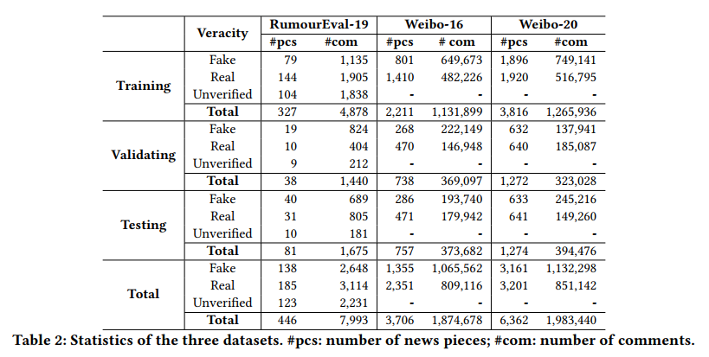
Experiments
English dataset
Chinese dataset
Notes:
English dataset,

Slide 11
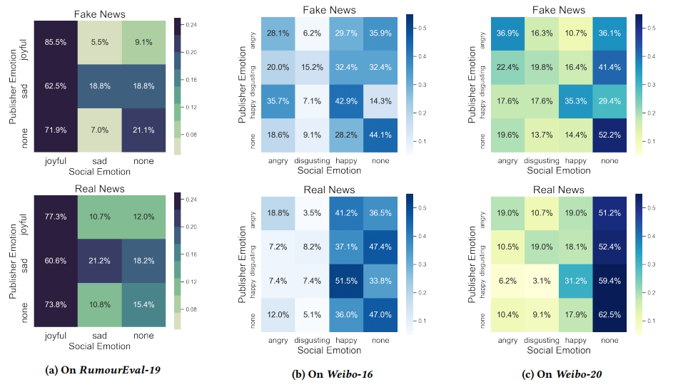
Experiments

Slide 12
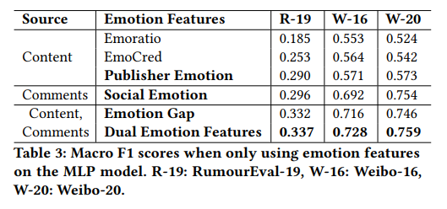
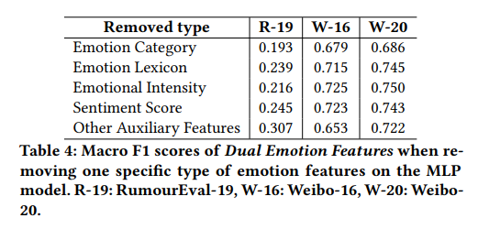
Experiments

Slide 13
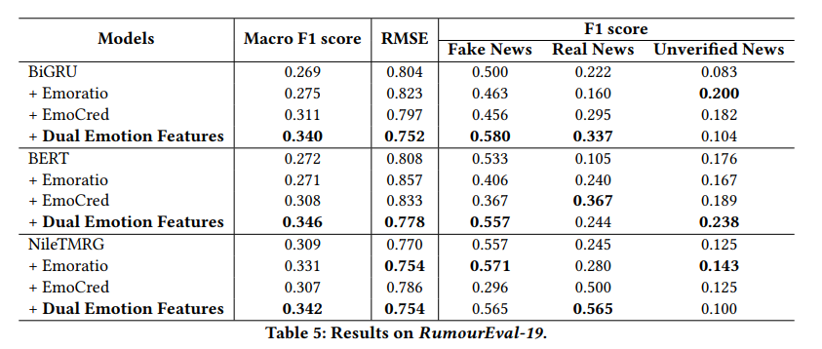
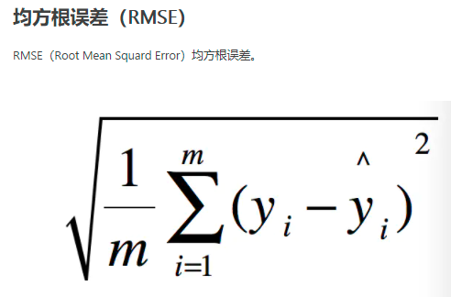
Experiments

Slide 14
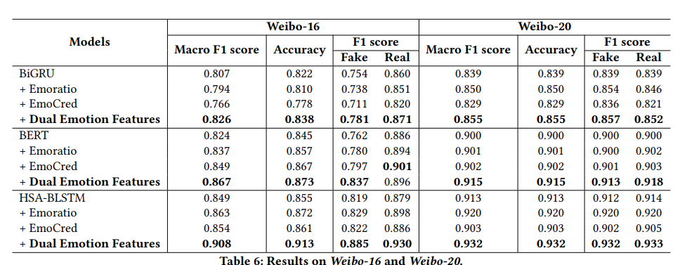
Experiments

Slide 15
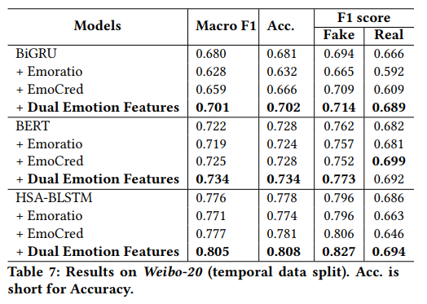
Experiments

Slide 16
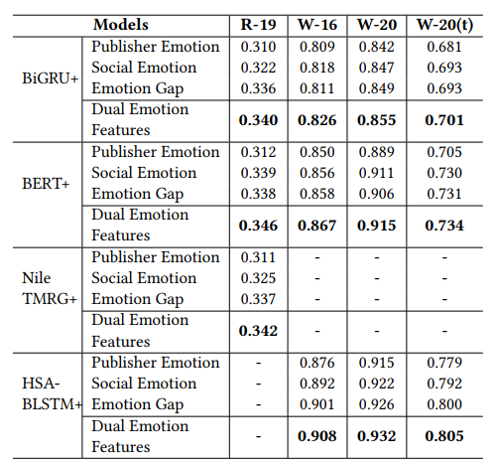
Experiments
Ablation study

Slide 17
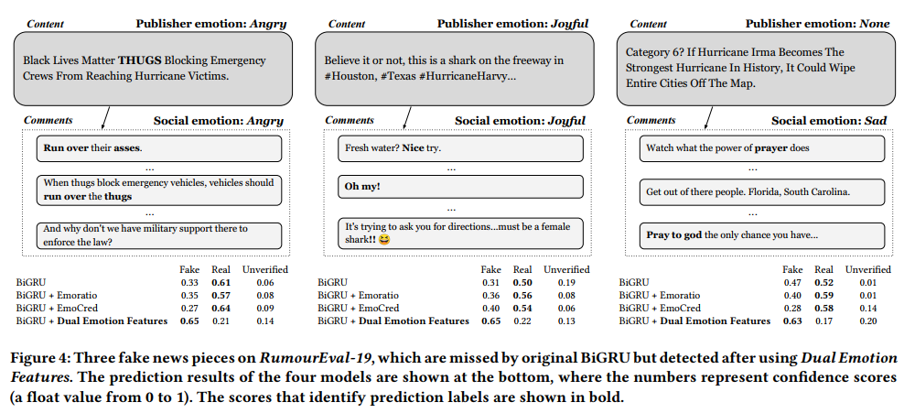
Experiments
Case Study
Notes:
Case Study

Slide 18
Thanks

